Slide 1
أكـــــاديميــــة طــــويـــق
Scalable Data Science

Slide 2
cuML for GPU-accelerated machine learning
By: Dr. Afshan Hashmi

Slide 3
Course Objectives:
Understand GPU-Accelerated Machine Learning – Learn how to leverage RAPIDS cuML for high-performance machine learning on large datasets, comparing it with traditional CPU-based approaches.
Implement Efficient ML Models – Develop and optimize machine learning models using cuML, including regression, classification, and clustering, to achieve faster training and inference times.
Apply cuML to Real-World Problems – Gain hands-on experience in applying GPU-accelerated ML techniques to practical use cases such as financial modeling, image recognition, and natural language processing.

Slide 4
Introduction to cuML(RAPIDS Machine Learning Library)
What is cuML?
cuML is an open-source GPU-accelerated machine learning library developed by NVIDIA as part of the RAPIDS AI framework. It provides highly optimized implementations of common machine learning algorithms using CUDA.
Why Use cuML?
Faster Computation: Leverages GPUs for parallel execution, significantly reducing training time.
Compatible with scikit-learn: Provides a similar API, making it easy to transition from CPU-based models.
Seamless Integration: Works well with cuDF (GPU-accelerated pandas) and other RAPIDS libraries.
cuML
Rapids Machine Learning Library

Slide 5
cuML overview
cuML is a machine learning library developed by NVIDIA as part of the RAPIDS ecosystem.
Its main goal is to accelerate traditional machine learning algorithms using GPU computing.
cuML offers GPU-accelerated versions of many popular algorithms found in scikit-learn, such as linear regression, k-means clustering, and random forests.
It is especially useful for large datasets and real-time applications, where traditional CPU-based libraries may become slow or inefficient.
It uses CUDA, NVIDIA’s parallel computing platform, to achieve high performance.
A major advantage is its API similarity to scikit-learn, making it easy for developers to switch with minimal code changes.

Slide 6
Significance of cuML
Traditional ML tools like scikit-learn use CPUs, which can be slow and inefficient for very large datasets.
cuML solves this issue by using GPU acceleration via NVIDIA CUDA, leading to much faster training and inference.
It's especially helpful in situations where real-time processing or big data is involved (e.g., streaming data or massive logs).
cuML can scale ML workflows that would otherwise be limited by CPU memory and speed.
It is particularly useful for data scientists and engineers who want faster experimentation and deployment cycles without changing much code.

Slide 7
Installation of cuML
cuML is part of the RAPIDS ecosystem developed by NVIDIA, and it depends on specific GPU drivers and CUDA versions.
Recommended installation method is through Conda because it handles all the dependencies (like cudatoolkit) more smoothly.
conda install -c rapidsai -c nvidia -c conda-forge \
cuml=24.02 python=3.10 cudatoolkit=11.8
-c rapidsai, -c nvidia, and -c conda-forge specify the channels to search for the packages.
cuml=24.02 specifies the version of cuML.
python=3.10 ensures compatibility with that Python version.
cudatoolkit=11.8 tells Conda to install the CUDA runtime compatible with your GPU.

Slide 8
Installation of cuML
Pip installation is available but has limited support, especially regarding complex dependencies:
pip install cuml-cu11 --extra-index-url=https://pypi.nvidia.com
Before installation:
Ensure your system has an NVIDIA GPU.
CUDA drivers should be properly installed.
Best to test in Google Colab or a Docker container if unsure about system compatibility.

Slide 9
cuML-Supported Algorithms
cuML provides GPU-accelerated implementations of various machine learning algorithms, including:
Linear Models: Linear Regression, Ridge Regression, Lasso Regression
Clustering: K-Means, DBSCAN
Dimensionality Reduction: PCA, t-SNE, Truncated SVD
Tree-based Models: Random Forest, Decision Trees
Other Models: Nearest Neighbors, Support Vector Machines, Gaussian Mixture Models

Slide 10
Using cuML's Linear Regression
This is a simple demonstration of how to use cuML to train and predict using Linear Regression, leveraging the GPU for computation:
import cuml
from cuml.linear_model import LinearRegression
import cupy as cp
# Generate sample data
X = cp.random.rand(1000, 3)
y = cp.dot(X, cp.array([3.5, 2.0, 6.7])) + 1.2
# Create and train model
model = LinearRegression()
model.fit(X, y)
# Predict
preds = model.predict(X)
print(preds[:5])
Imports:
cuml.linear_model.LinearRegression: cuML's version of
scikit-learn's LinearRegression, GPU-accelerated.
cupy: Like NumPy but for GPU arrays.
Generates 1000 rows and 3 feature columns of random
data on the GPU.
Creates a target variable y using a linear equation. Basically: y = 3.5*x1 + 2.0*x2 + 6.7*x3 + 1.2
Creates and fits a linear regression model using GPU arrays.
Makes predictions and prints the first 5 results.

Slide 11




Real-World Applications of cuML
Finance: Risk modeling, fraud detection, stock price prediction
Healthcare: Genomic analysis, patient diagnosis predictions
Retail: Customer segmentation, demand forecasting
Cybersecurity: Anomaly detection in network traffic
This Photo by Unknown Author is licensed under CC BY-SA-NC

Slide 12
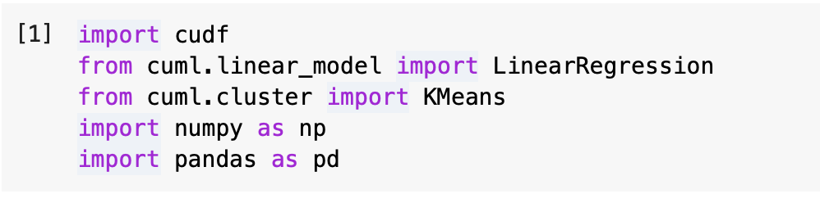
Importing cuML and Dependencies
cudf: A GPU-accelerated DataFrame library similar to pandas, optimized for NVIDIA GPUs.
cuml.linear_model.LinearRegression: GPU-accelerated linear regression model.
cuml.cluster.KMeans: GPU-accelerated K-Means clustering algorithm.
numpy and pandas: Used for handling arrays and data processing before converting them into GPU-optimized structures.
This setup ensures that machine learning workflows leverage GPU acceleration instead of CPU-based operations.

Slide 13
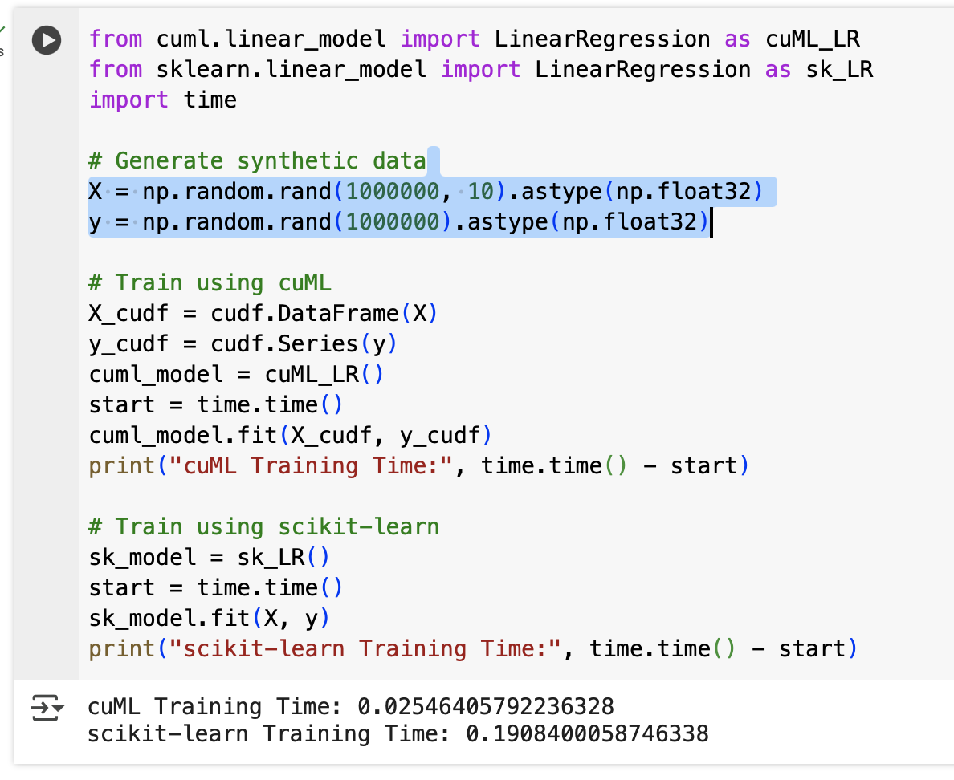
cuML vs. Scikit-Learn Speed Comparison
Uses cudf.DataFrame and cudf.Series to transfer data to the GPU.
Measures and prints the execution time for both implementations.
Demonstrates the potential speedup of cuML over scikit-learn for large datasets.

Slide 14
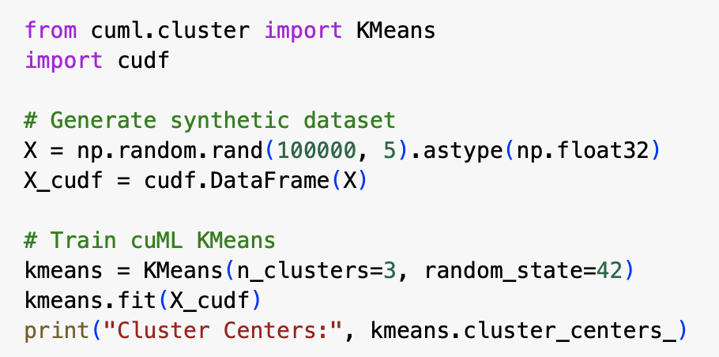
GPU-Accelerated K-Means Clustering
Implements GPU-based K-Means clustering, which is significantly faster than CPU-based implementations.
Uses cudf.DataFrame to store data in a GPU-compatible format.
Computes cluster centers efficiently using GPU-accelerated processing.
Helps in segmentation tasks, such as customer grouping in retail or anomaly detection.

Slide 15
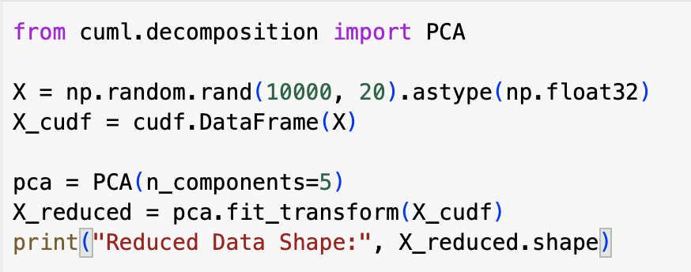
GPU-Accelerated Principal Component Analysis
Implements GPU-accelerated PCA, which reduces dimensionality faster than traditional PCA methods.
Uses cudf.DataFrame for efficient GPU memory handling
Helps in feature extraction and compression in large datasets.
Essential for preprocessing high-dimensional datasets in computer vision, bioinformatics, and NLP.

Slide 16
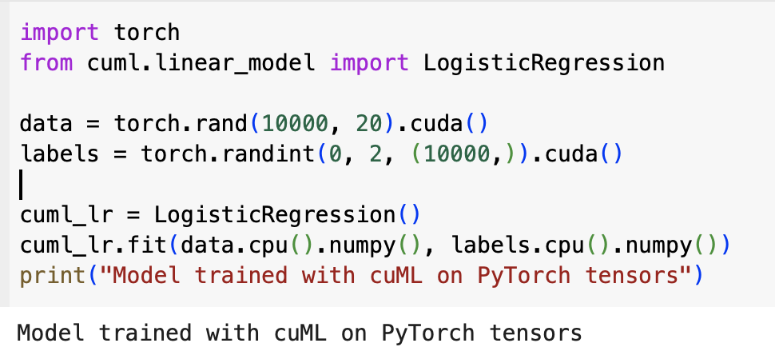
Integrating cuML with Deep Learning (TensorFlow/PyTorch)
Shows how cuML can work alongside deep learning frameworks like PyTorch.
Moves data to GPU using .cuda(), but transfers it to CPU (.cpu().numpy()) before using cuML (since cuML does not support PyTorch tensors directly).
Enables hybrid machine learning and deep learning workflows, useful in reinforcement learning, AI-powered security, and fraud detection.

Slide 17
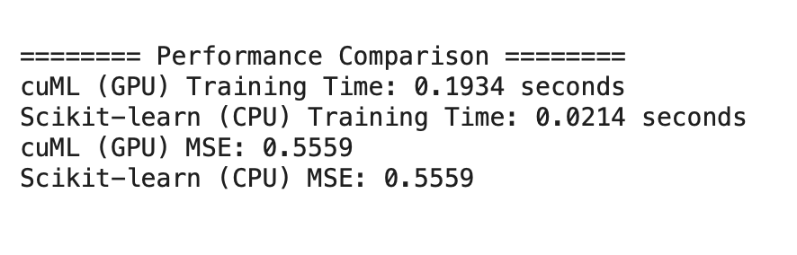
Project : Predicting House Prices using cuML
Steps:
Load the dataset (California housing dataset from sklearn).
Preprocess the data and move it to cuDF for GPU processing.
Train a Linear Regression model using cuML.
Compare performance with Scikit-learn (CPU-based).
Evaluate the model's performance (MSE & Training Time).
For Full code click here

Slide 18
Performance Tips in cuML
To get the most out of cuML's GPU acceleration.
Since the whole idea behind cuML is faster ML on GPUs, following these tips ensures maximum efficiency:
Keep data in GPU memory:
Use cupy (for arrays) or cuDF (for DataFrames).
Transferring data back and forth between CPU and GPU slows down performance.
Avoid frequent CPU-GPU transfers:
Minimize operations like to_pandas() or cp.asnumpy(), which move data off the GPU.
Use RAPIDS Memory Manager:
For large-scale ML tasks, this helps manage GPU memory efficiently and avoid memory overflows.
Monitor GPU usage with nvidia-smi:
This command-line tool helps you track memory usage, running processes, and GPU load in real time.
These tips are essential for building high-performance machine learning pipelines using cuML, especially with large datasets or real-time applications.

Slide 19
Advantages and Limitations of cuML
Advantages:
Massively Parallel Computation: Ideal for large datasets.
Easy Transition from scikit-learn: Similar API.
Optimized for NVIDIA GPUs: Provides huge speedups.
Limitations:
Requires NVIDIA GPU: Not useful for CPU-only environments.
Memory Constraints: GPU memory is limited compared to CPU RAM.
Limited Algorithm Support: Some ML models are not yet implemented in cuML.

Slide 20
Comparison of cuML with Scikit-learn
Aspect | Scikit-learn | cuML
Hardware | CPU | GPU
Speed | Slower for large datasets | Faster due to GPU acceleration
Scalability | Limited by CPU memory | Handles larger datasets efficiently
Ease of Use | Beginner-friendly | Requires GPU knowledge
Algorithm Coverage | Extensive | Limited but growing

Slide 21
Recap
cuML provides GPU-accelerated versions of popular machine learning algorithms.
It offers significant performance improvements over traditional CPU-based libraries like scikit-learn.
The API is designed to be familiar to scikit-learn users, allowing for easy transition.
cuML is part of the RAPIDS ecosystem, enabling seamless integration with cuDF and other GPU tools.
Ideal for big data and real-time ML applications that demand speed and scalability.
A valuable tool for data scientists aiming to harness the power of NVIDIA GPUs for ML workloads.

Slide 22

Practical Implementation
Click on the link below to go to Google COLAB
Click HERE

Slide 23

















الشراكات العالمية

Slide 24
شــــــكــــرًا لكــــــم
THANK YOU

